Slide 1


E-Commerce website
-presented by team asap

Slide 2

Contents
Observations
Key Features
Software Development Process
Technologies Used
Demonstration

Slide 3
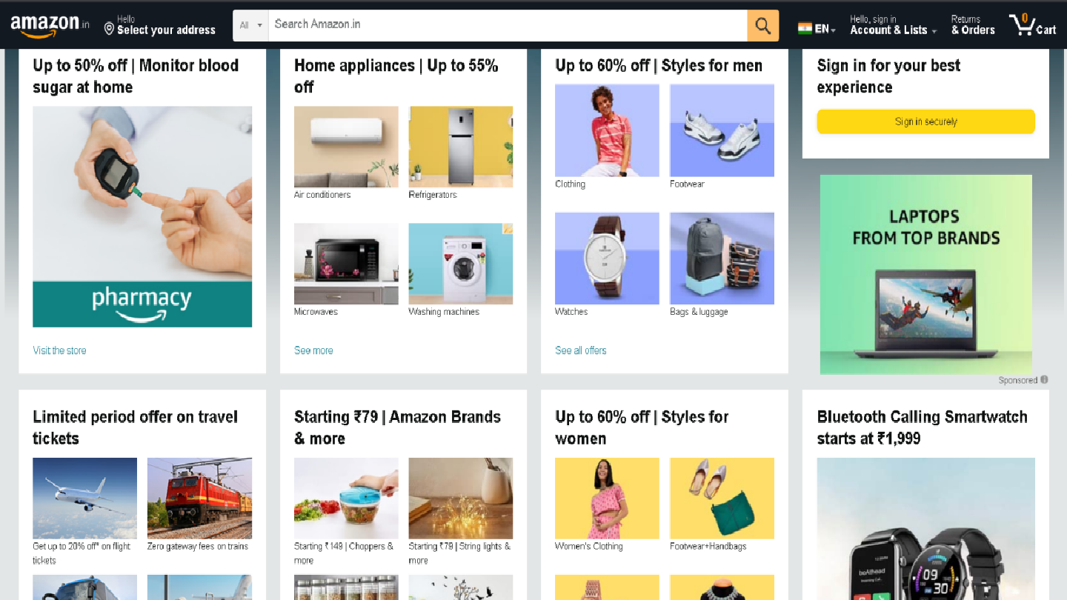
Observations

Slide 4
Key Features

Slide 5
Streamlined UI
Our attempt is to make a more streamlined, clutter-free UI with the minimal amount of irrelevant information & ads given to the user

Slide 6
2) Price Tracking Feature
User is able to track the price of any product he desires
The user gets notified when the price of the product drops below a certain point that the user has set.

Slide 7



SDLC
Extreme Programming
Agile Process
Scrum

Slide 8
Technologies Used:
Frontend
Backend
React
Redux
Bootstrap
Tailwind CSS
Font Awesome
Axois
Node JS
Mongoose
Bcrypt
JSON Web Token

Slide 9
DEMO

Slide 10
Thank You

